Slide 1
Semantic segmentation in R using Keras and U-Net
Michał Maj
29.09.2019

Slide 2

Who am I
My name is Michał Maj:
- Linkedin https://www.linkedin.com/in/michal-maj116/
- Twitter @MichalMaj116
I am a Data Scientist at Billenium.
I am interested in machine learning and statistics. I love new challenges and I'm always ready to help solving data science problems. I'm a big R language enthusiast and a frequent guest in R Enthusiasts meetups in Gdańsk (https://www.meetup.com/Trojmiejska-Grupa-Entuzjastow-R/).
Hobbies: cosmology, string theory, AI, swimming

Slide 3
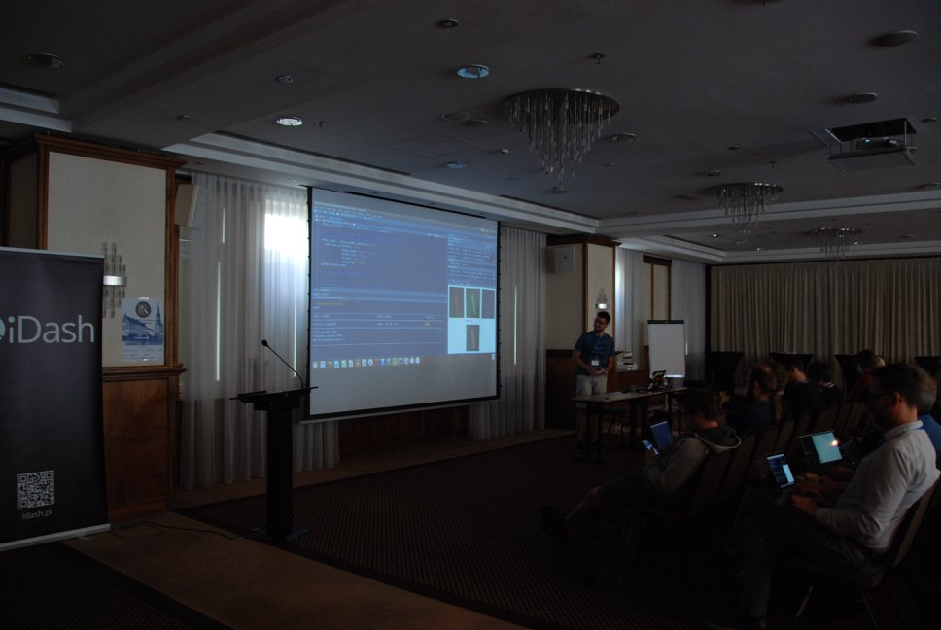
I was here before
2018:
Introduction to deep learning with Keras in R
2017:
Machine learning with H2O and R

Slide 4
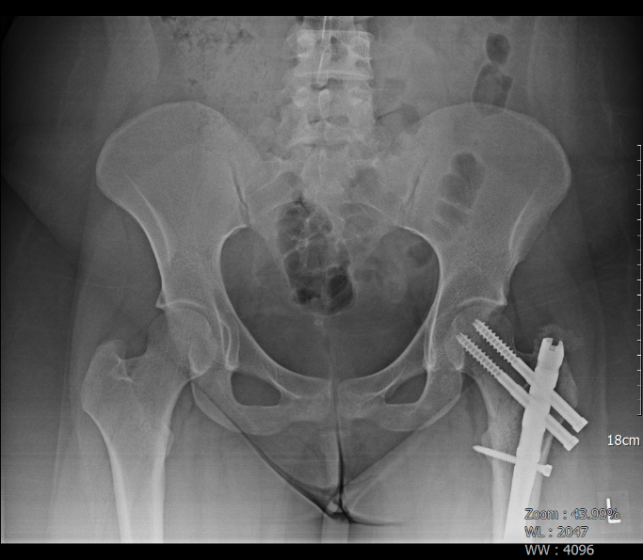
My first big deep learning project
One of many projects from program called “e-pionier”, financed by EU.
Goal:
Create a system that could predict:
if patient need a hip replacement surgery
patient medical condition (e.g urgent, stable) - 4 categories
has pathological changes in the hip joints (e.g cysts, osteophytes) - 5 types of changes
give doctors an easy to understand explanation of the model and prediction

Slide 5
Steps
Step 0 :
collect the data (few thousands of DICOM X-ray images of hip joints)
anonymization (remove from DICOMs personal patient info - name, address etc.)
create a labels / descriptions
Step 1 :
deep learning model(s) for hip joint replacement, pathological changes and patient condition (CLASSIFICATION)
Step 2 :
create a system that using above model(s) and patient information (e.g. age, sex, medical history) will give the final prognosis and explanation.

Slide 6
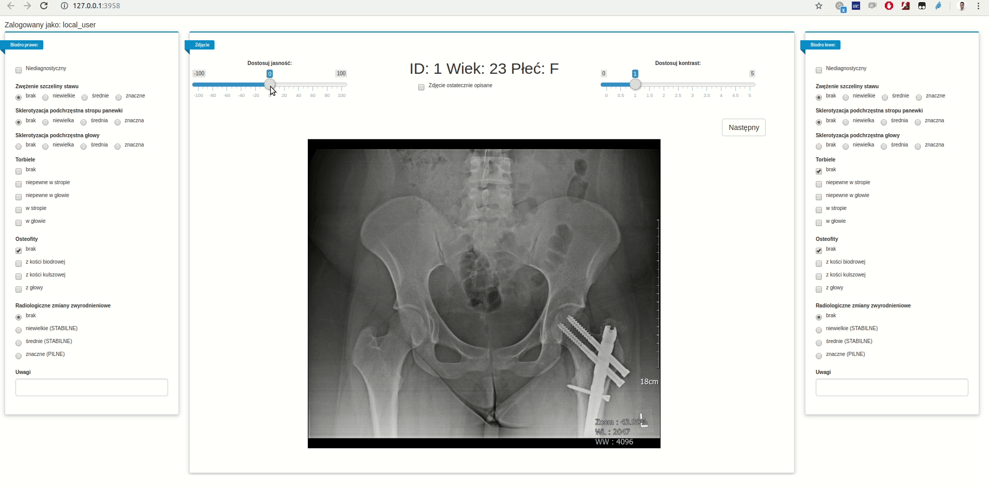
Where are we now ?

Slide 7
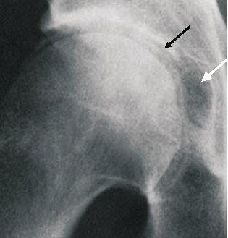
Possible future steps
Step 2:
Semantic segmentation of pathological changes on hip joint X-ray images
Source: https://www.researchgate.net/figure/CC-of-Hip-Joint-Black-arrow-with-large-subchondral-cyst-White-arrow_fig1_260943060

Slide 8
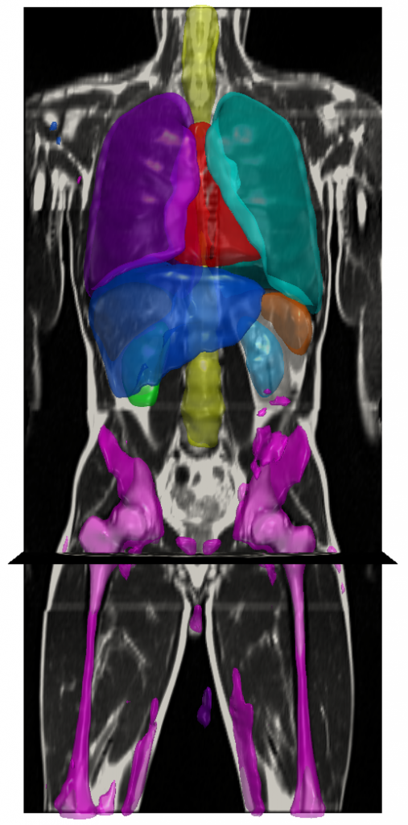
Semantic segmentation
Semantic segmentation is a computer vision task in which instead of classifying the whole image we’re classifying each pixel on an image.
Existing models/architectures for semantic segmentation:
FCN
Feature Pyramid Network
ParseNet
U-Net
many more
Source:
https://wiki.tum.de/display/lfdv/Image+Semantic+Segmentation

Slide 9
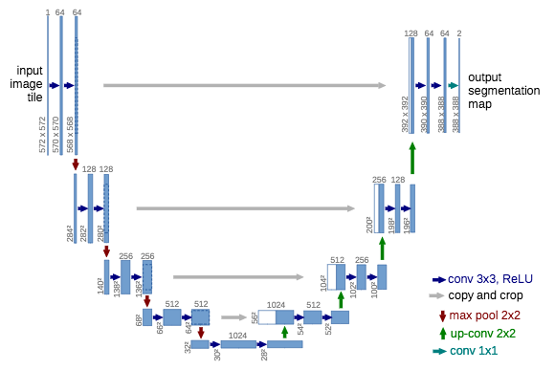
U-Net
Source: https://medium.com/@arthur_ouaknine/review-of-deep-learning-algorithms-for-image-semantic-segmentation-509a600f7b57

Slide 10
Platypus - R package for computer vision
First version of a package should be available at January 2020:
Generalized U-Net for semantic segmentation
YOLO (You Only look Once) for object detection
Data generators, loss functions and additional functions
Future work:
Faster R-CNN for object detection
Other algorithms for semantic segmentation
Mask R-CNN for instance segmentation
Real-time prediction using webcam

Slide 11
Questions ?

